Slide 1

Interlake Boat Measurement
A Step-by-Step Guide to
Measuring Interlakes as of 2013

Slide 2
General Rules
If a boat:
  does not appear on the database;
  has a new owner; or
  if the measurement value is “OK”,
it must be measured and the numerical values entered on the Measurement Form.
The measured value (in inches, not feet and inches) must be entered on the form.
Use the 2” mark on the tape measure rather than the absolute end, which could have wear or a right angle fitting.
Notes:
If feet and inches are inadvertently entered, it’s not a disaster. The Chief Measurer is usually smart enough to figure out which is which.

Slide 3
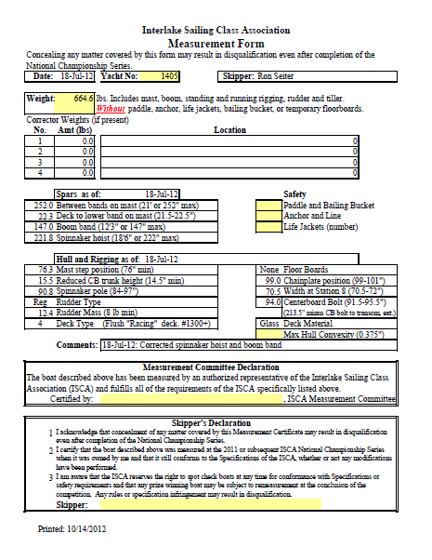
Measurement Form
Boat Mass
Spars
Safety
Hull
Measurement Committee Signoff
Competitor Signoff

Slide 4
Hull
Rudder
  Type (Regular or Spade)
  Mass (excluding tiller)
    8.0 lbs minimum
Deck Type
  1,2,3,4,5, or 6 (Custom)
Deck Material
  Wood or Fiberglass
Floorboards
  Yes or No. “Yes” means permanent. Removable floorboards must be removed before the boat is weighed.

Slide 5
Hull (cont)
Mast Step – Distance from Bow to forward face of mast
  76.0” minimum
Reduced CB Trunk Height
  14.5” minimum
Chainplate Position
  99 – 101” (Older boats at 99 – 106” are OK)
Spinnaker Pole Length
  84 – 97”
CB Pivot Bolt Position
  91.5 – 95.5” (213.5” minus the distance between the Bolt and the transom measured along the curvature of the hull)

Slide 6
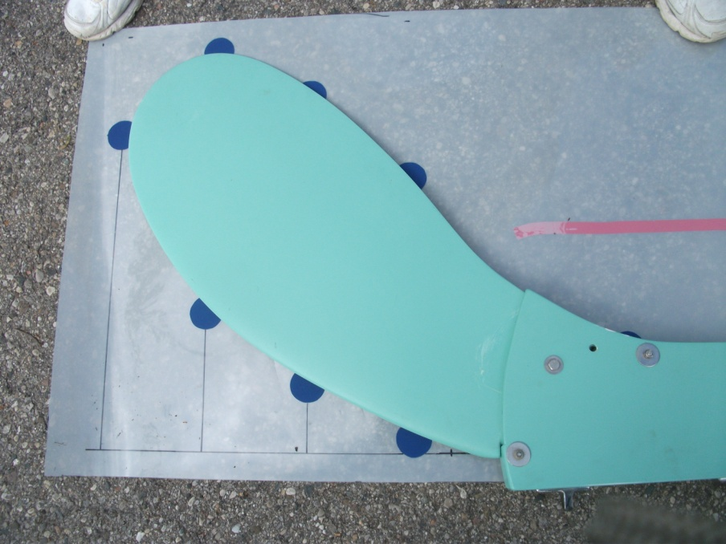
Rudder
Rudder Type is:
“Regular” or
“Spade”
Rudder must also be weighed (8.0 lb minimum)
The regular rudder must be laid on the template in such a way that the edge “breaks” all of the blue circles.
                There are very few of the rectangular “spade” rudders left in use.
Weigh the rudder on the scale used for weighing the boats or other suitable scale.
DO NOT include the tiller when weighing.
A rudder weighing less than 8.0 lbs. cannot be corrected by adding a corrector weight. Adding a weight does not add strength.

Slide 7
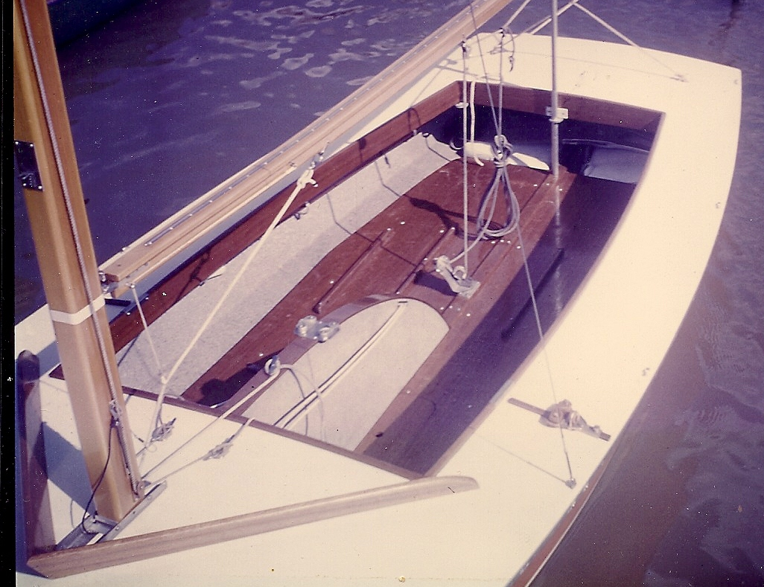
Deck Types
Deck Type 1
Original fiberglass deck from Station 8 to Station 16. #160 - 460
No seats. May have floorboards over entire cockpit
May have a wooden splash rail.

Slide 8
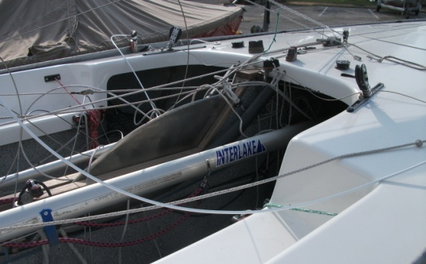
Deck Types
Deck Type 2
Original seated fiberglass deck from Station 8 to Station 16.

Slide 9
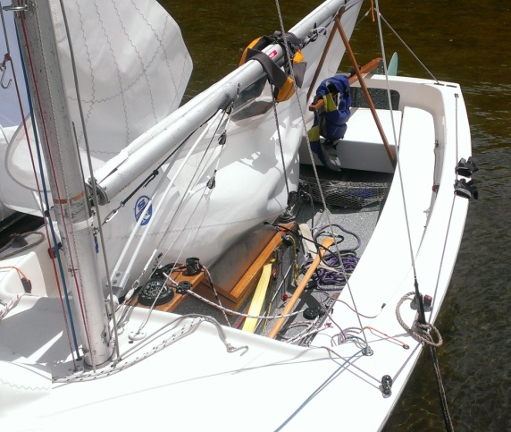
Deck Types
Deck Type 3
Extended seated deck.
Cockpit extends from Station 7 to Station 18
#1040-? Seats extend to transom.

Slide 10
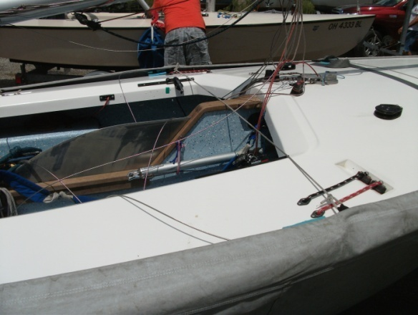
Deck Types
Deck Type 4
Flush "Racing" deck.
Hull #1300+
Cockpit extends from Station 7 to Station 16

Slide 11
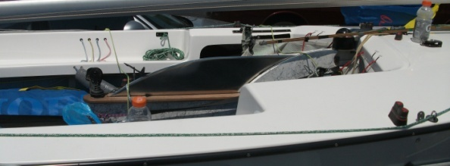
Deck Types
Deck Type 5
Newer seated deck #1300+. Similar to 4, but with seats.

Slide 12
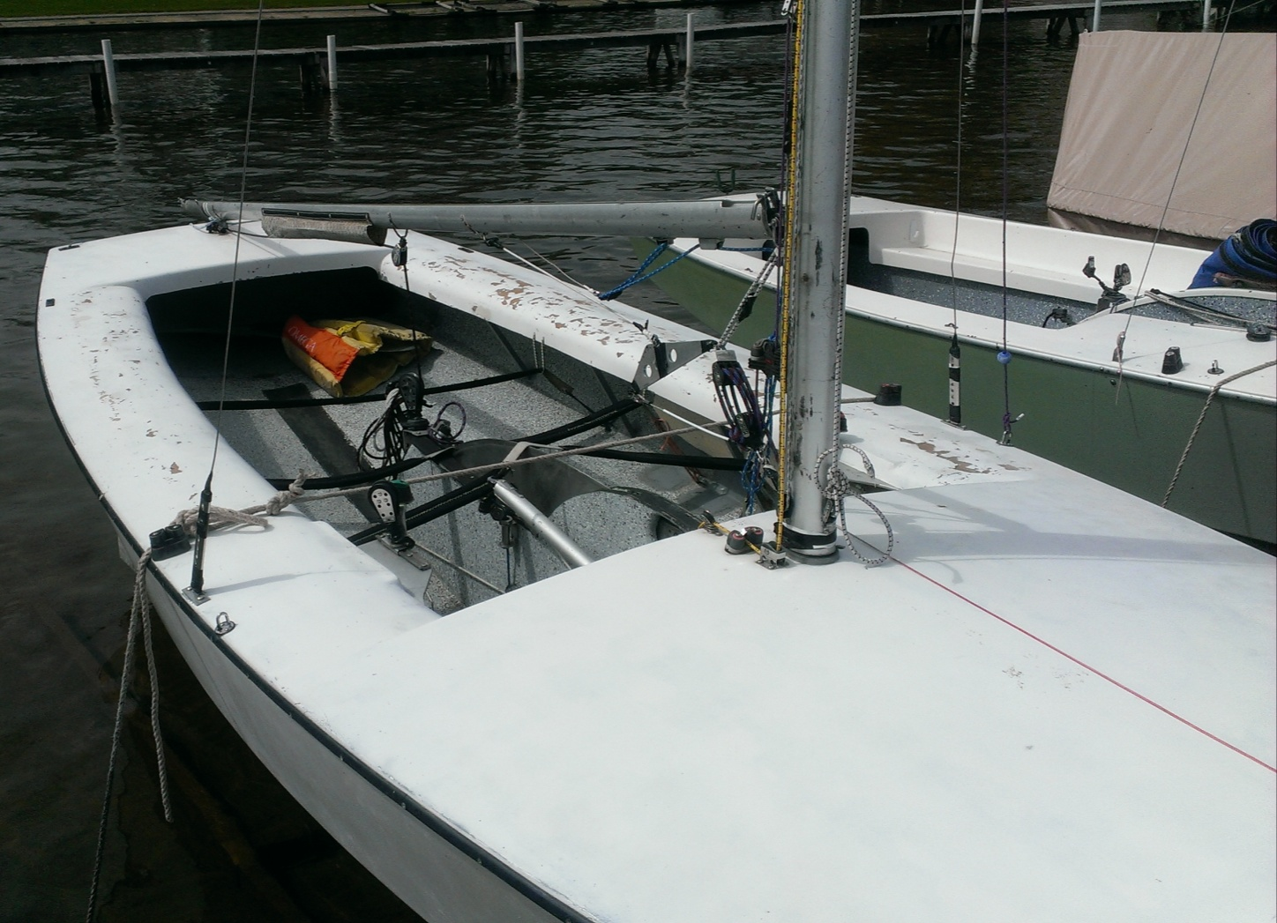
Deck Types
Deck Type 6
Custom or home built.
(#1000 shown).
Notice rolled side deck (not beveled) and forward edge of cockpit.

Slide 13
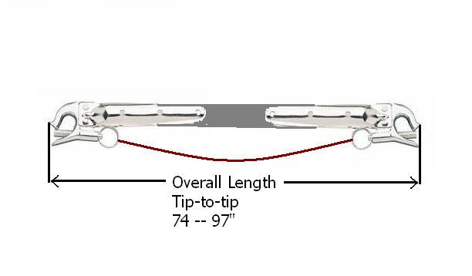
Spinnaker Pole
Pole Length
Overall length, tip-to-tip
Not inside-to-inside
Not inside-to-outside

Slide 14
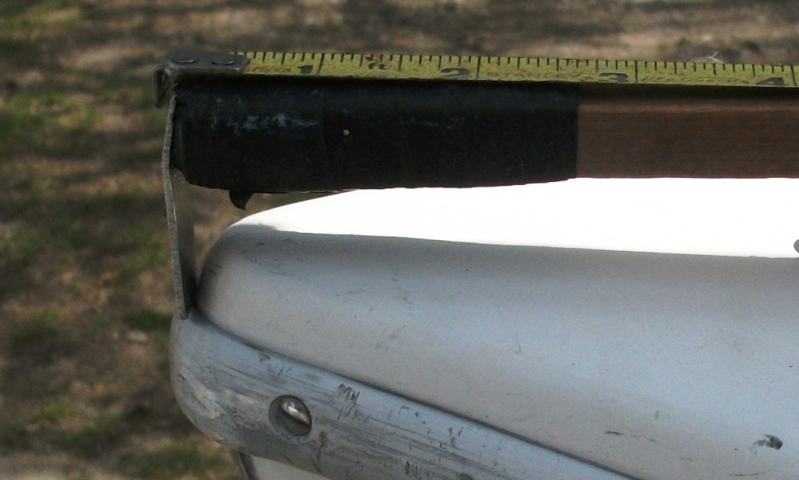
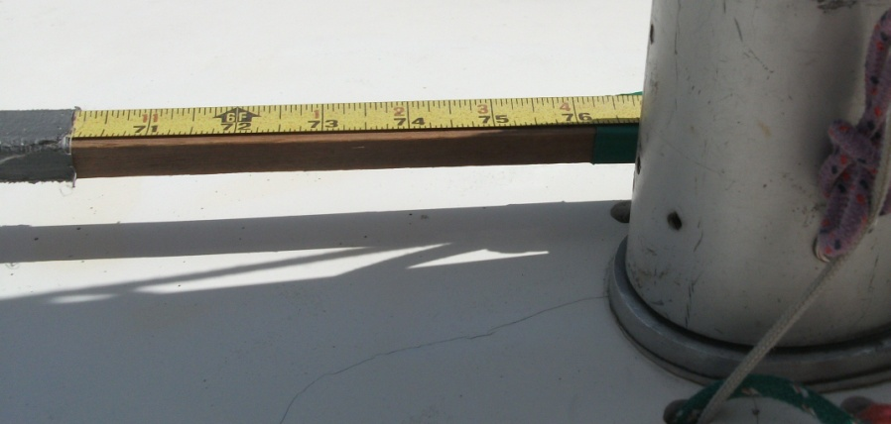
Mast Position
Bow Point
The intersection of the hull and deck.
DOES NOT include the rub rail.
Front of Mast
The front of the mast itself
NOT the mast step.
76” minimum.
Most boats are 76-76.25”

Slide 15

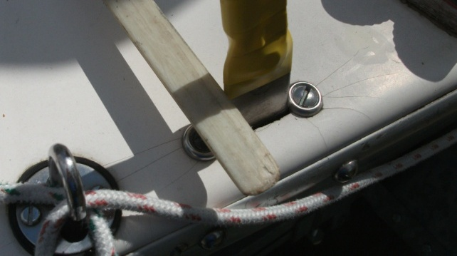
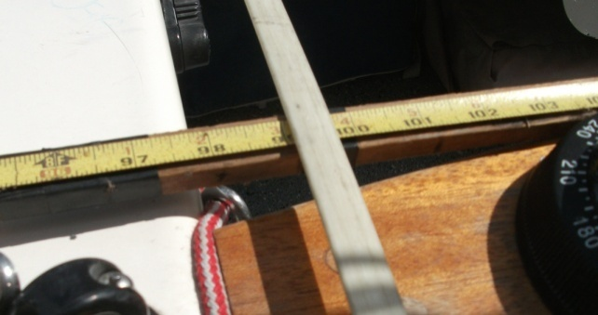
Chain Plate
Bow Point
The intersection of the hull and deck.
DOES NOT include the rub rail.
Front or Rear of Chain Plate
Place the measurement stick ahead or behind both chain plates
(Ahead shown)
0.50”
Measurement
Where stick crosses the tape, add or subtract ½” for half the width of the chain plate fitting (99.75 + 0.50 = 100.25” as shown at right.

Slide 16
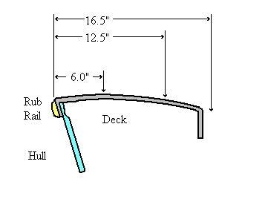
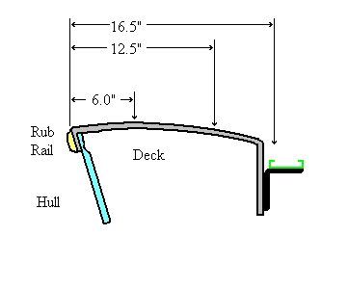
Cockpit Dimension
Requirement
16.5” in from the edge of the deck (excluding rub rail) a vertical line downward must hit the hull, not anything permanently attached to the deck.
J OK
Visual Inspection
Keep an eye out for added jib fairlead tracks.
A moveable jib car that extends into this area IS NOT A VIOLATION
L Not OK

Slide 17
Centerboard Trunk
Non-enclosed Trunks
Measure from the bilge to the top of the trunk
14.5” minimum
Need Picture
Enclosed Trunks
Enter “99” on the form.

Slide 18
CB Pivot Bolt
Performed on hoist while weighing
2 person operation
The stick is inserted into the trunk and held alongside the board against the CB Pivot Bolt.
Stick is bent along the hull and the measurement made at the transom.
Subtract the number from 213.5” and enter the result on the form.
Need Pictures

Slide 19
Spars
Lower Mast Band – Distance from Deck (inc. Mast Step Thickness)
  21.5 to 22.5”
Upper Mast Band – Distance From Lower Band
  21’ (252”) maximum
Boom Band – Distance from Mast
  12’ 3” (147”) maximum
Spinnaker Hoist – Distance from Deck to Upper side of sheeve.
  18’ 6” (222”) maximum

Slide 20
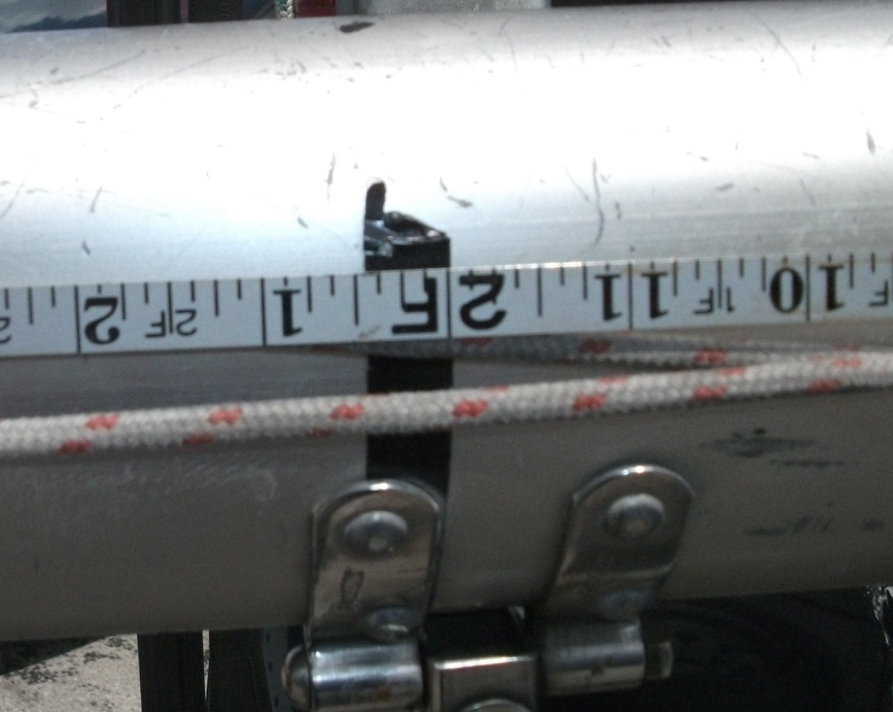
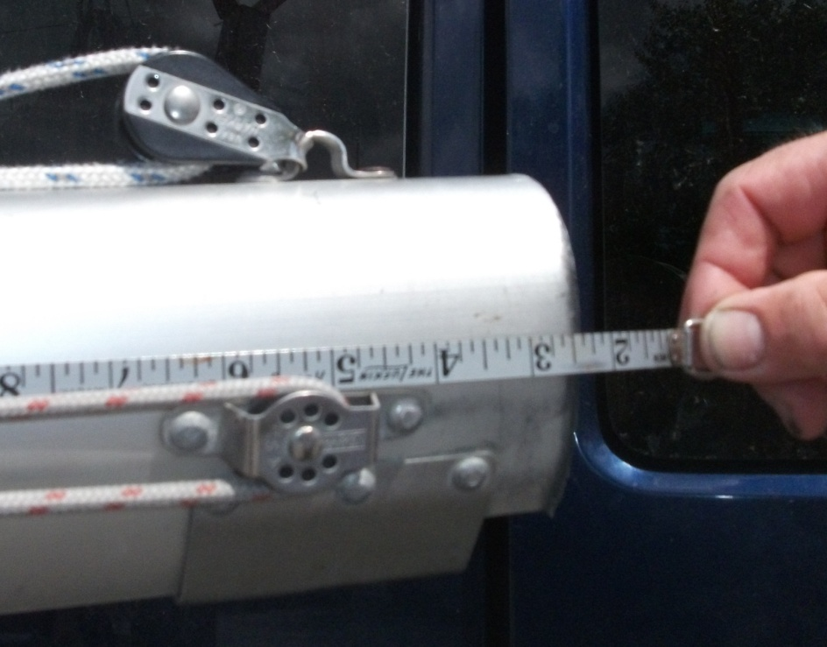
Lower Mast Band
The measurement must be taken from the upper side of the band to the nearest 1/8” (Here, 24.5”, minus 2” for the tape measure equals 22.5” entered on the form.
Usually, the 2” mark should be placed 3/8” below the butt of the mast to account for the 3/8” thickness of the mast step.

Slide 21
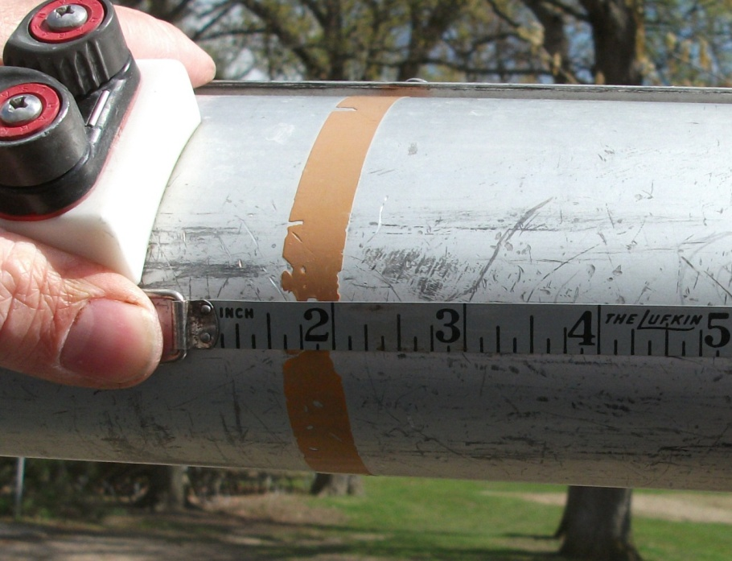
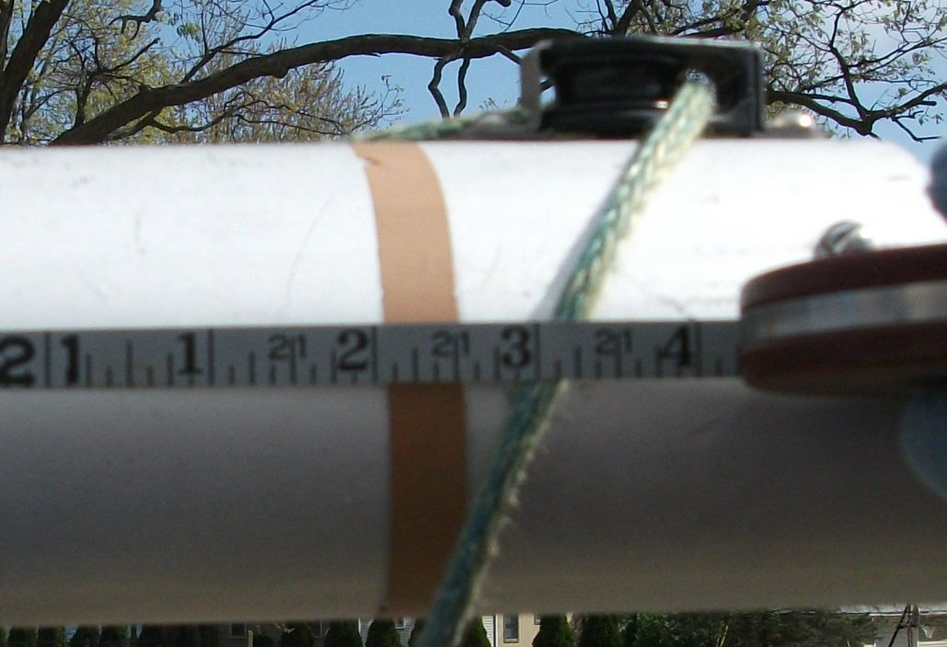
Upper Mast Band
Place the 2” mark on the upper edge of the lower mast band.
The measurement is made to the lower edge of the upper band. Subtract 2” because the upper end of the lower band is at the 2” point and enter the resulting number (i.e. 252.0”)

Slide 22
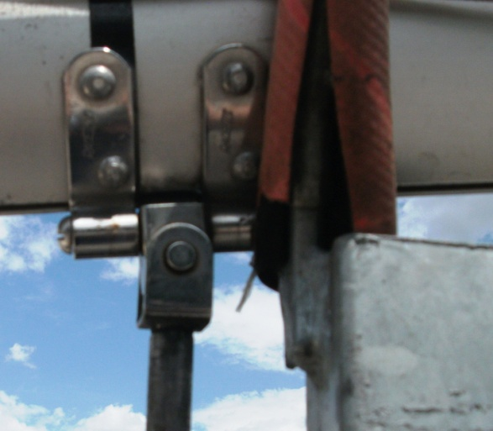
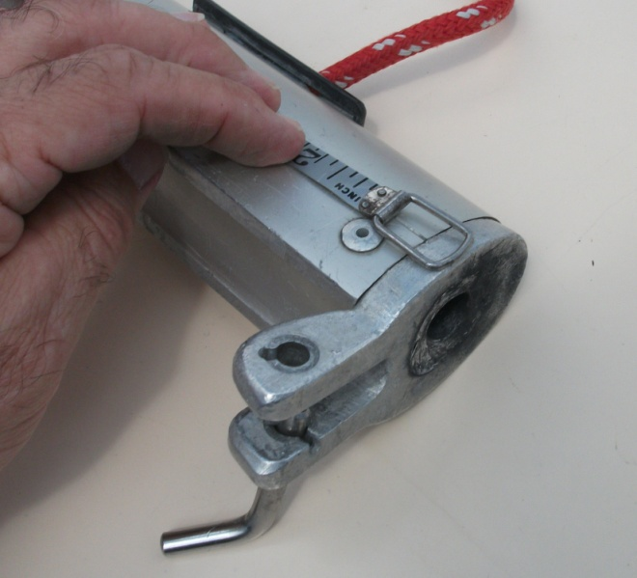
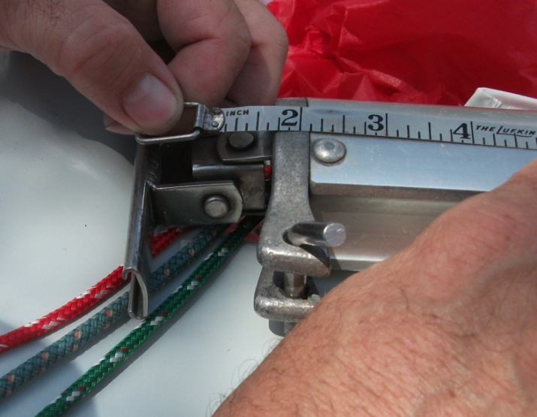
Boom Band
1.5”
Add 1.5” for gooseneck
The most common gooseneck is 1.5” from the back of the mast to the face of the boom
The measurement is taken from the face of the boom to the inside of the boom band. The minimum is 147”, including the 1.5” of the gooseneck at left. Enter the number in inches (i.e. “147.25”, not “12’ 3.25”)
The older, adjustable gooseneck should be measured from the track that runs up and down on the mast. No allowance for gooseneck.

Slide 23
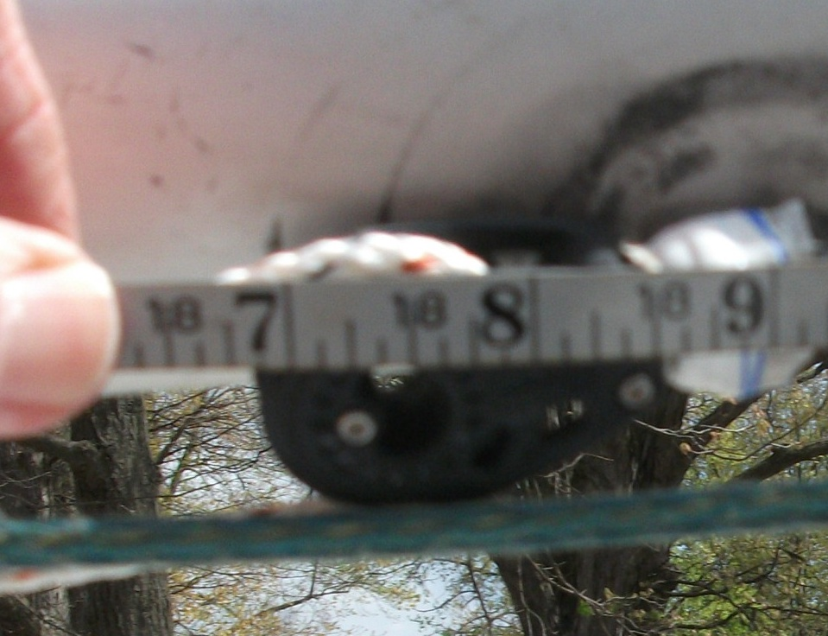
Spinnaker Hoist
Place the 2 3/8” mark on the upper edge of the lower mast band to account for the 3/8” mast step.
The measurement is made to the top of the sheeve when lying flat against the mast. The maximum is 18’ 6” or 222”. Remember to subtract the 2” for the bottom measurement.

